Slide 1
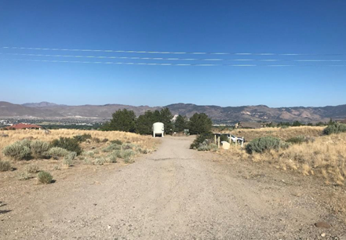
WADMIN20-0010
The Club at ArrowCreek Pickleball Court
Washoe County Board of Adjustment
December 3, 2020

Slide 2
Request
The request is for an administrative permit to allow for the use of indoor sports & recreation for a 9,000 sq. ft. indoor pickleball court on a 149-acre property
Also, to allow for grading of a 669 sq. ft. of several man-made areas which exceed 30% slope located within the proposed parking lot and drop-off area

Slide 3
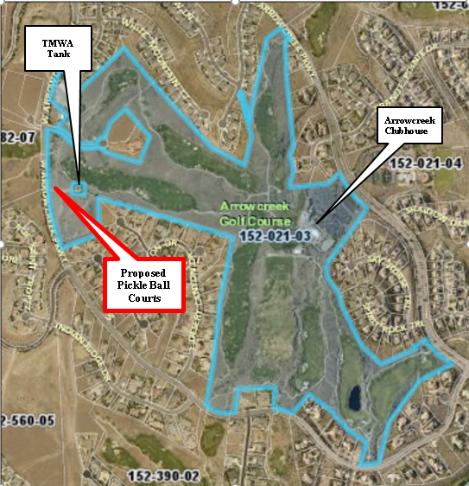
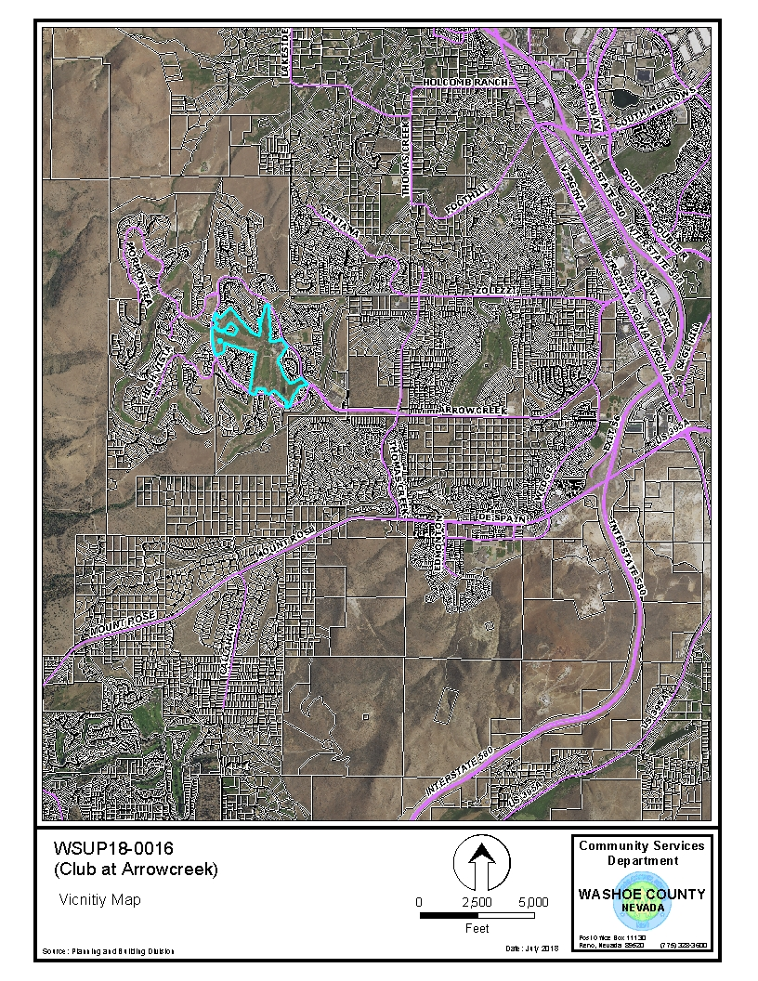

Slide 4
Background
The Club at ArrowCreek is a member only facility with two 18-hole golf courses and associated facilities
Over the past few years new facilities have been added and updated to further the sustainability of the overall facility

Slide 5
Background
In 2018 indoor sports & recreation use type was approved for a 7,000 sq. ft. pickleball facility adjacent to the clubhouse in the Club parking lot area
However, the applicant decided to move the location of the courts because of impacts to views for the neighboring properties’ and loss of parking spaces in the parking lot

Slide 6
Analysis
The applicant is now proposing to construct a 9,000 sq. ft. pickle ball court approximately 2,400 feet northwest of the clubhouse adjacent to a Truckee Meadows Water Authority (TMWA) water tank
The building will include 4 indoor pickleball courts, restrooms and storage area and operate from 7 AM to 9 PM

Slide 7
Analysis
The applicant indicates that there will be 46 parking spaces, with two ADA spaces along with parking for golf carts
The pickleball site consist of 1.68 acres (73,300 sq. ft.) and 30,576 sq. ft. (41%) of the site will be landscaped.
The applicant states that the while the courts are being re-located and the original traffic study, which concluded that traffic impacts would be minimal to the area, is still valid

Slide 8
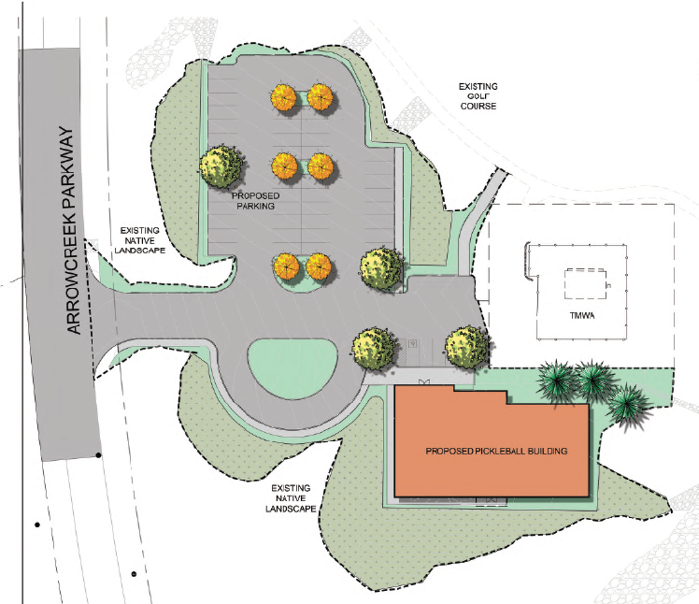

Slide 9
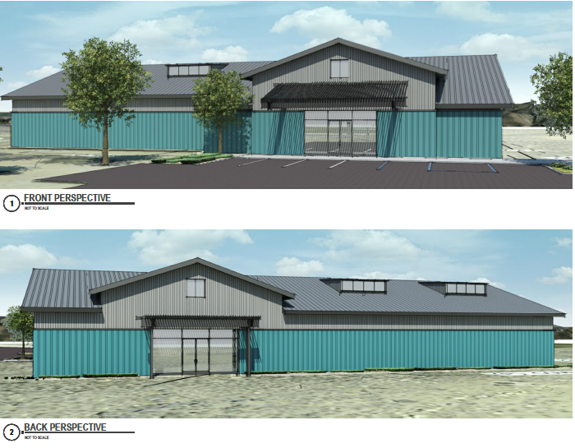

Slide 10
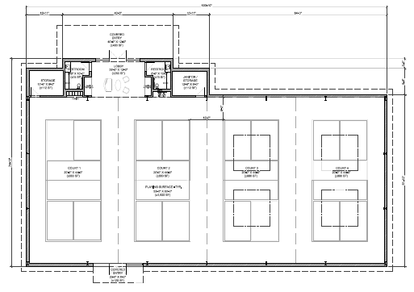

Slide 11
Grading
The request includes grading for a few man-made areas of 30% slope located on the site and per WCC 110.438.35(a)(3) “any driveway or road that traverses any slope of thirty (30) percent or greater (steeper)”, meets the major grading threshold
Typically this requires a special use permit (SUP) for major grading, however an administrative permit receives the same review as a SUP and the administrative permit has been deemed to meet the major grading review requirement and the request has be included in the administrative permit

Slide 12
Grading
The 30% slope area is located where the parking lot and drop off area is proposed to be located and the area is approximately 669 sq. ft. in size
Approximately 4,983 cubic yards of material will be cut from the site to prepare the site for development
Any excess material will be move to other locations on the parcel

Slide 13
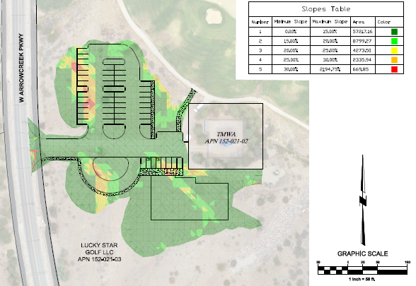

Slide 14
Public Notice & CAB
Notices were sent to 239 parcels
The South Truckee Meadows/Washoe Valley CAB reviewed the application on November 5, 2020 and unanimously recommended approval of the request with very little discussion
I did receive emails in support of the pickleball courts since the staff report was completed that have been distributed to the BOA members

Slide 15
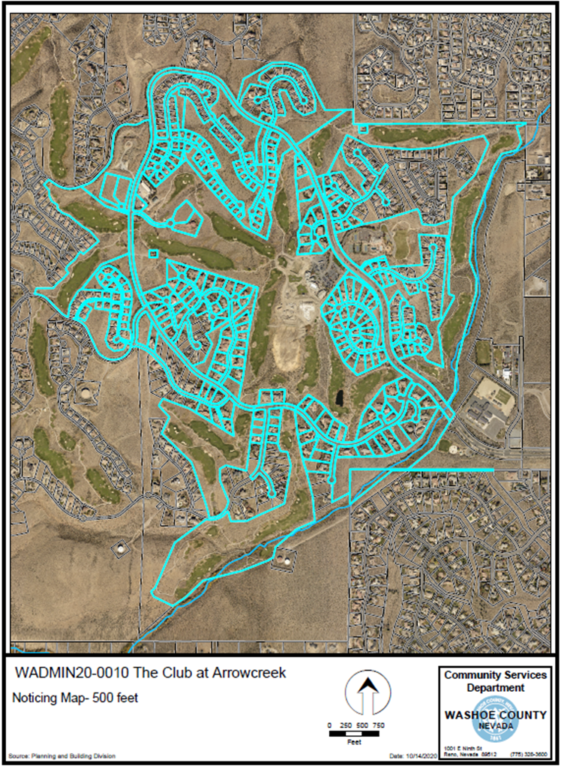

Slide 16
Reviewing Agencies
The reviewing agencies had no issues with the application and conditions are included in your staff report.

Slide 17
Findings
Staff is able to make all the required findings, as detailed in the staff report on Page 10-11

Slide 18
Administrative Permit Motion
I move that, after giving reasoned consideration to the information contained in the staff report and information received during the public hearing, the Board of Adjustment approve with the conditions included as Exhibit A to this matter, Administrative Permit Case Number WADMIN20-0010 for Lucky Star Golf, LLC, having made the four findings in accordance with Washoe County Code Section 110.808.25

